Slide 1

Predicting Dengue Fever Outbreaks
Anuj Anand, Smit Kiri, Nitin Kumar Mittal, Nicole Reitz, Fenil Shah
DS 5110, Northeastern University
December 02, 2019

Slide 2
Problem Statement
Use climate data to predict dengue fever outbreaks (number of cases) by week in San Juan, Puerto Rico and Iquitos, Peru.
What is Dengue Fever?
Mosquito-borne illness common in 110+ countries worldwide; 60 million+ cases annually.¹
Causes a painful rash, flu-like symptoms, severe muscle and joint pain, sometimes death.¹
Carried by the Aedes genus of mosquito. Related species responsible for spread of Zika Virus, Yellow Fever, and other diseases.²
Why Climate Data?
Mosquito populations are closely tied to climate conditions.
Understanding the relationship between climate and mosquito-borne illness will allow researchers
and medical professionals to prepare for the global health effects of climate change.³
Read more about this challenge at DrivenData⁴

Slide 3
Data
About the Data
Consolidated by NOAA* from multiple sources for the “Predict the next Pandemic” initiative.⁶
Weekly observations include counts of reported dengue cases and climate variables.
Total of 1456 observations; 936 for San Juan and 520 for Iquitos.
18 years of data for San Juan (1990-2008); 10 years of data for Iquitos (2000-2010).
Key Features:
Mean dew point temperature (K)
Mean relative humidity (percentage)
Mean specific humidity
Average temperature (C)
Diurnal (daily) temperature range (C)
Maximum temperature (C)
Minimum temperature (C)
Total precipitation (mm)
Total dengue cases reported that week
*National Oceanic and Atmospheric Administration ⁵

Slide 4
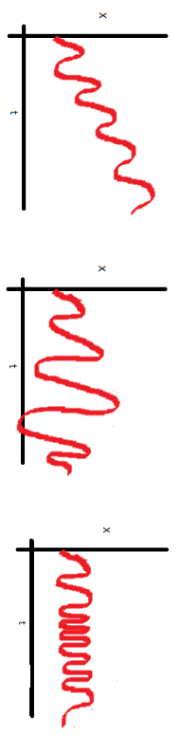
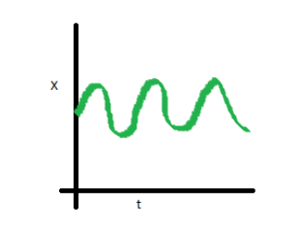
Time Series Models: Concepts and Limitations
In a time series model, the dependent variable is predicted by previous values of itself (univariate) and possibly other factors (multivariate) along fixed intervals of time.⁷
Key Concepts
Trend: general pattern of a value observed over a given time period (e.g., increasing, decreasing).⁸
Seasonality: short-term movements occuring in data due to seasonal factors (i.e., periodic changes over time).⁸
Cycles: long-term oscillations occurring in time series (generally extended from 5 to 12 years or more).⁸
Irregularity: sudden changes occuring in time series which are unlikely to be repeated. ⁸
Stationarity: mean, variance, and covariance do not vary with time.⁹
Note: Many time series models assume stationarity, a condition not met by our data! However, data transformations can create stationary conditions for modeling.
Mean not constant
Variance not constant
Covariance not constant
Mean, Variance and Covariance are constant

Slide 5
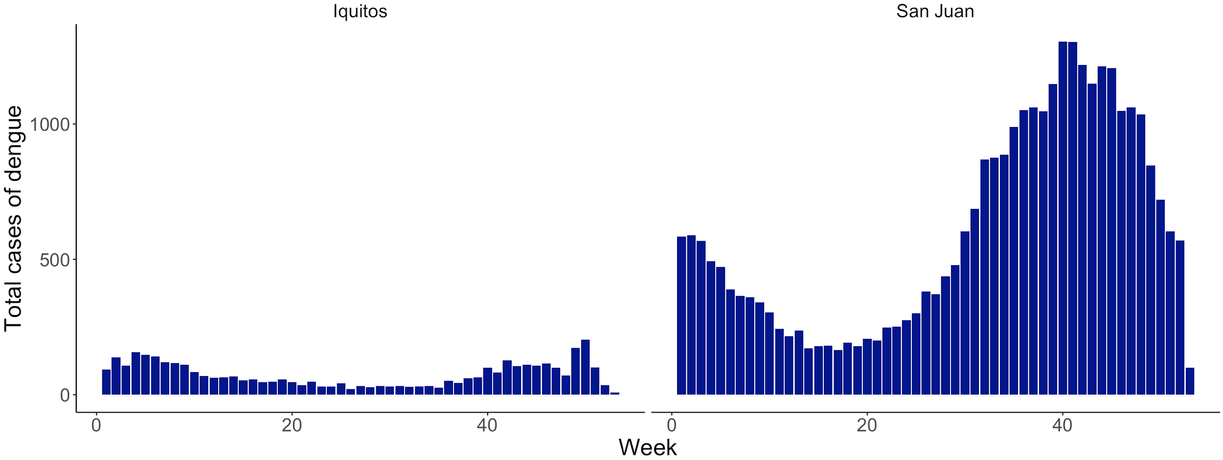
Exploratory Data Analysis: Seasonality
At a high level, our data appears to be seasonal. Models must account for the peaks in dengue cases observed from October-February in Iquitos and September-December in San Juan.
Total Dengue Cases by Week of Year and City

Slide 6
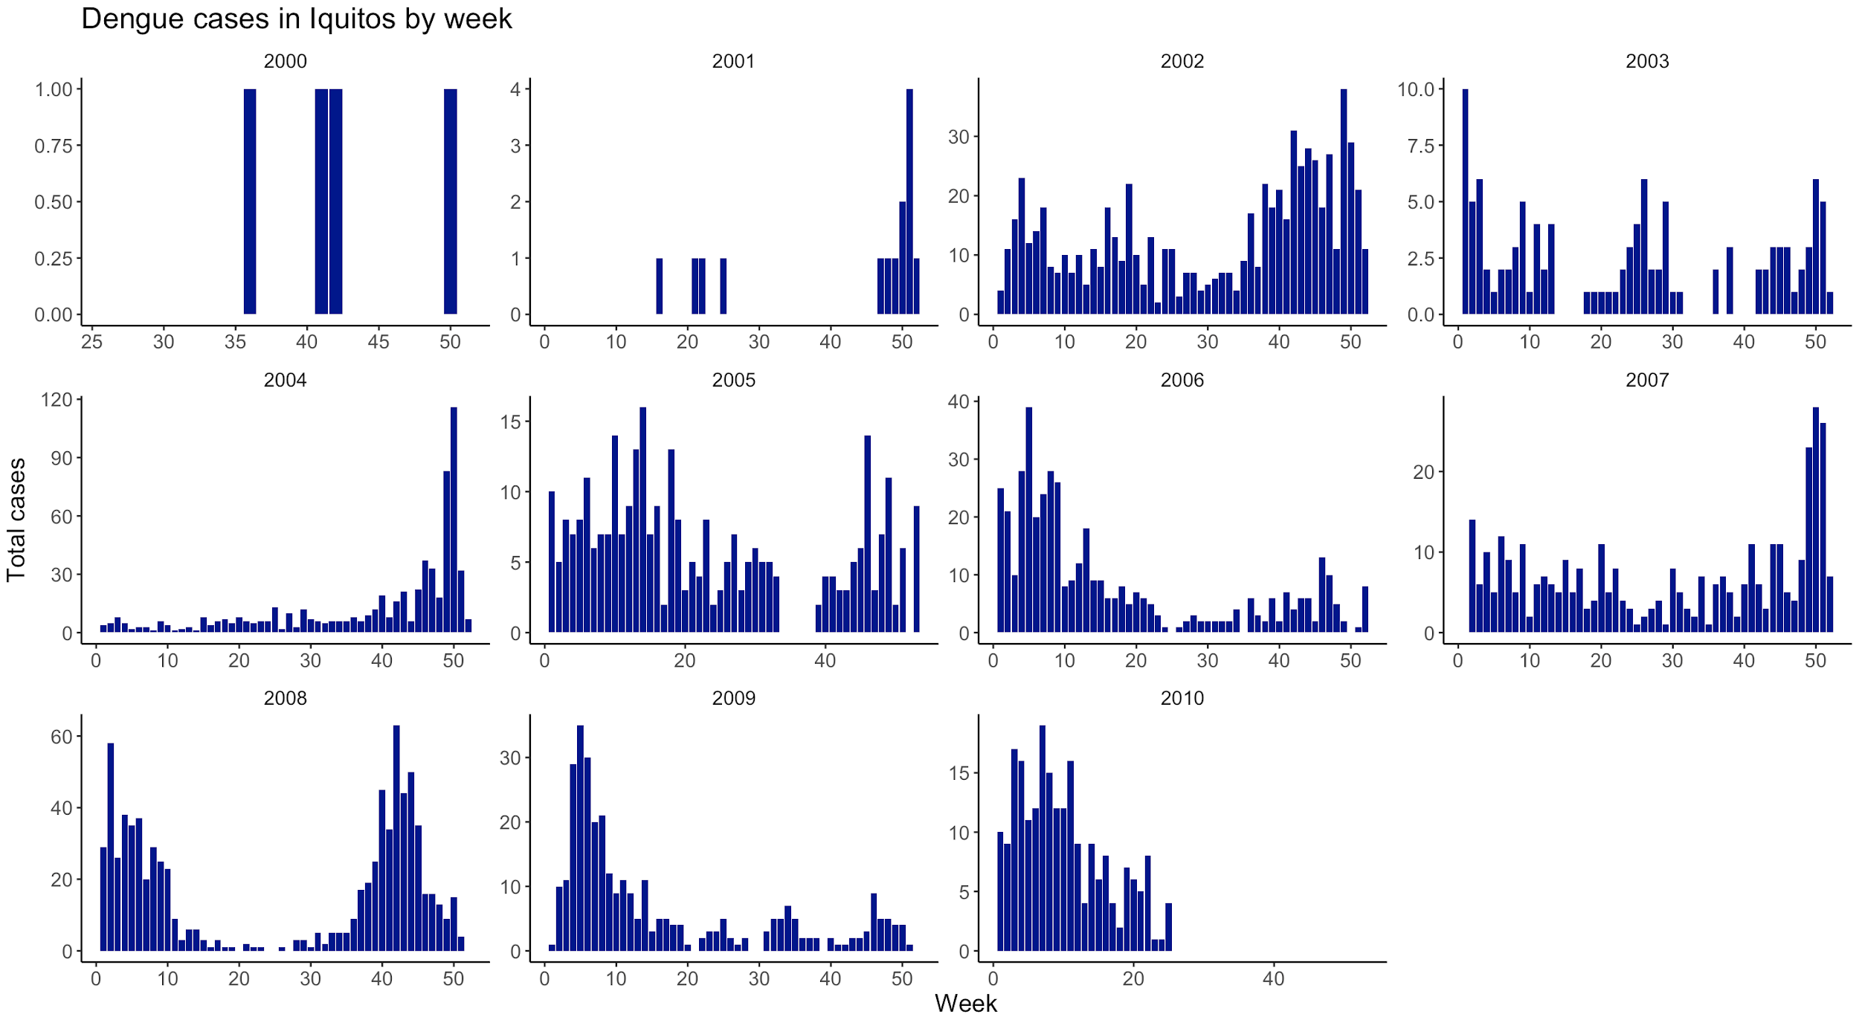
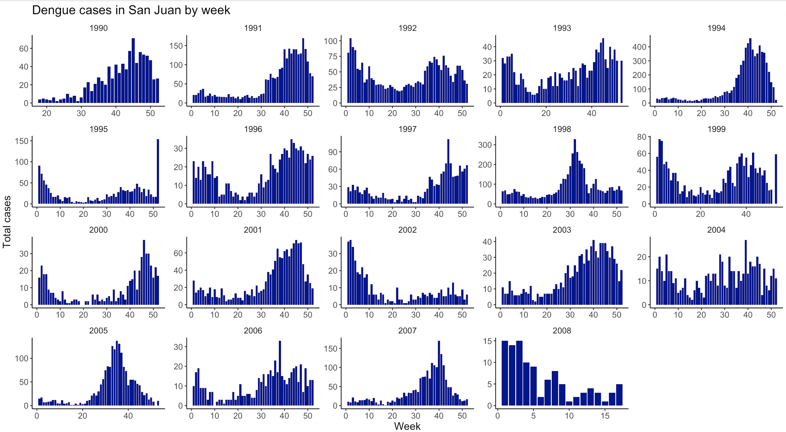
Exploratory Data Analysis: Seasonality
However, the exact timing of outbreaks varies by year and region, defying the predictability of “true” seasonality.
Dengue cases in Iquitos by week
Dengue cases in San Juan by week

Slide 7
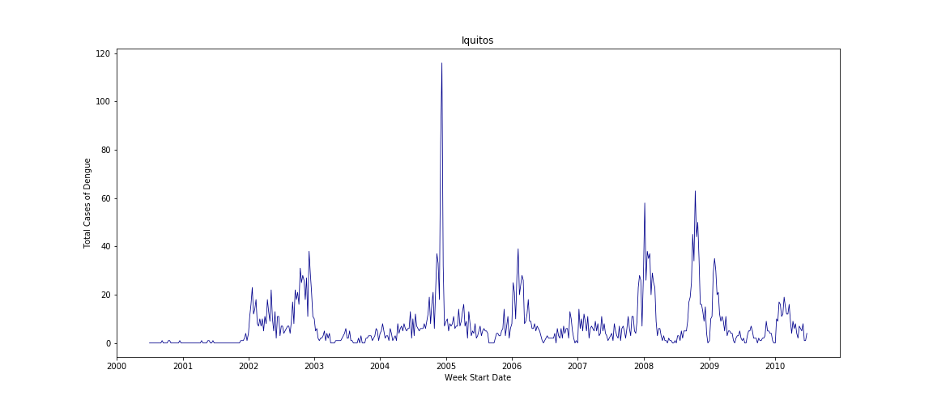
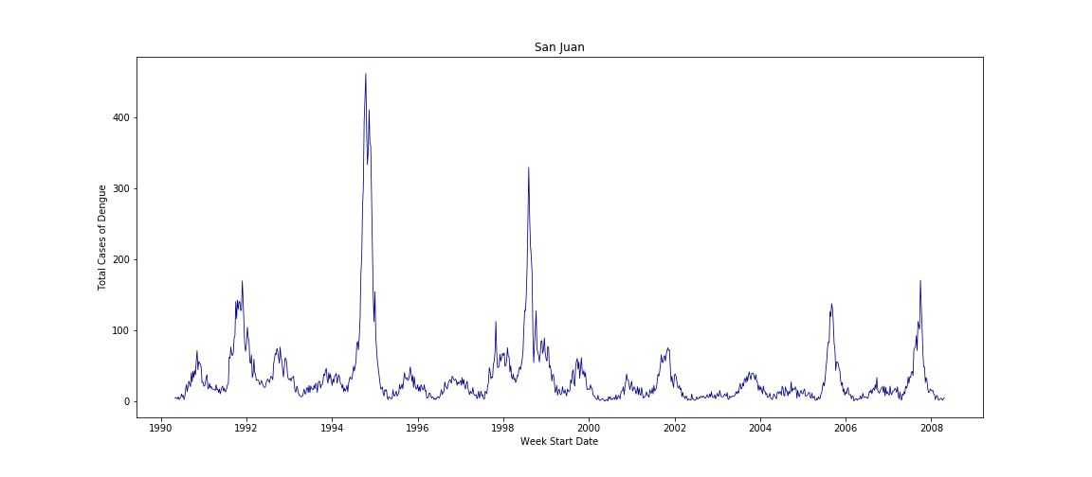
Exploratory Data Analysis: A Multivariate Problem
Irregularities in the timing and height of year-over-year peaks indicate that there are factors other than time impacting the number of dengue cases in each city.
Dengue Cases by City and Year
Iquitos
San Juan

Slide 8
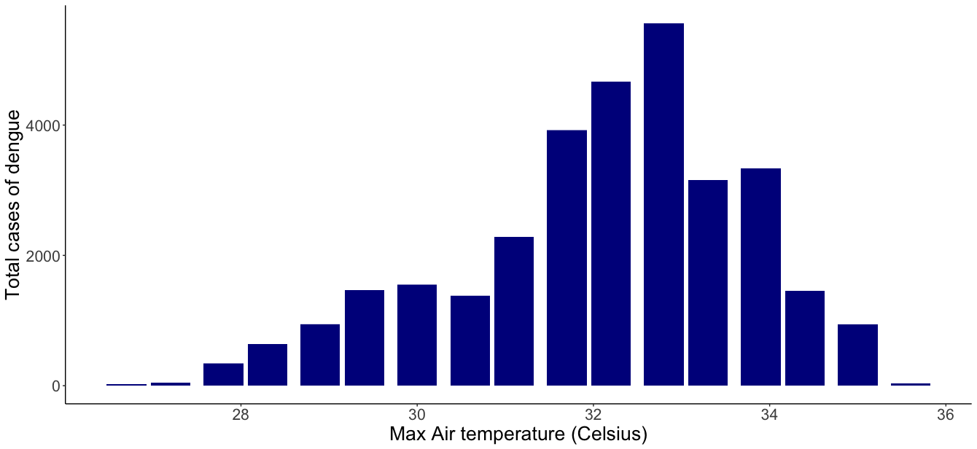
Exploratory Data Analysis: Temperature
Maximum dengue cases occur on days with temperature between 32 to 34 degrees Celsius.

Slide 9
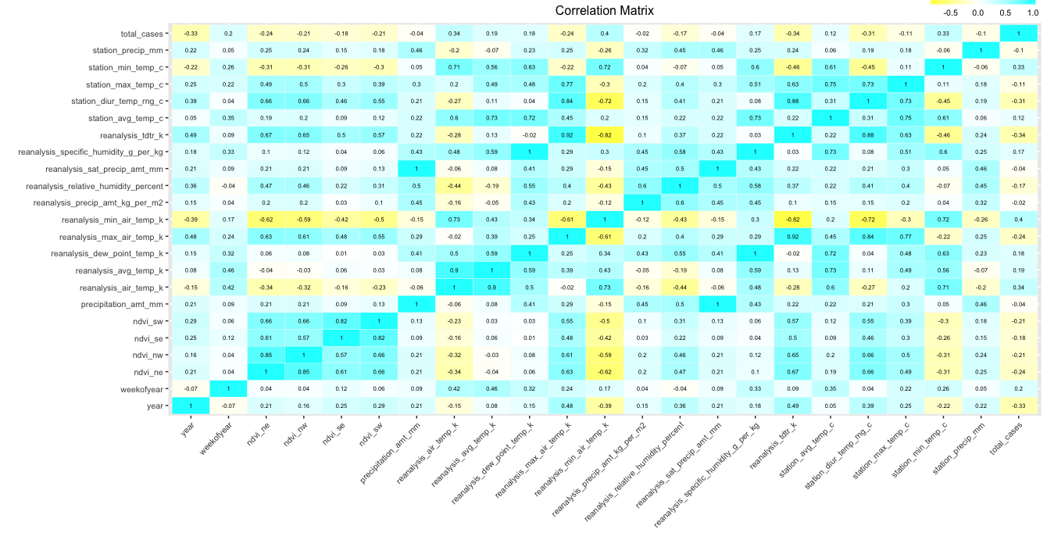
Exploratory Data Analysis: Collinearity
Correlation matrix of all variables in the dataset suggests that climate variables may not be completely independent from one another. In some cases, variables are two different measures of the same value! Model fitting requires narrowing to an independent set of predictor values to avoid overfitting.

Slide 10
Approach: Preprocessing
Split data to model by city
Split each city into train/test sets
San Juan: 800 weeks for training and 136 weeks for testing
Iquitos: 400 weeks for training and 120 weeks for testing
Impute missing values as needed
Replaced NA values with column mean
Feature selection
Selected 11 independent, non-redundant features
Feature scaling
Scaled values to comparable value ranges for multivariate methods
Feature extraction using Principal Component Analysis (PCA)

Slide 11
Approach: Modeling
Autoregressive Integrated Moving Average (ARIMA)
Univariate method
Time series model that uses target value “lags” and “lagged forecast errors”
as predictors for linear regression.¹⁰
Prophet Forecasting Model
Univariate method
Facebook-released “additive model where non-linear trends are fit with yearly,
weekly, and daily seasonality, plus holiday effects.”¹¹
Long Short-term Memory (LSTM)
Multivariate method
Recurrent Neural Network that learns from “long term” relationships between
factors as well as “short term” trends.^{12,13}
Tested with and without PCA

Slide 12
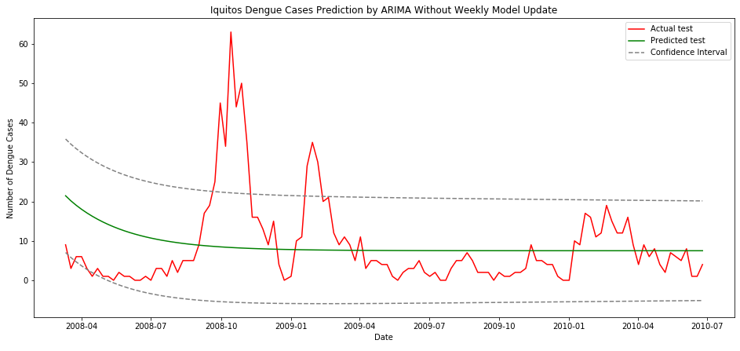
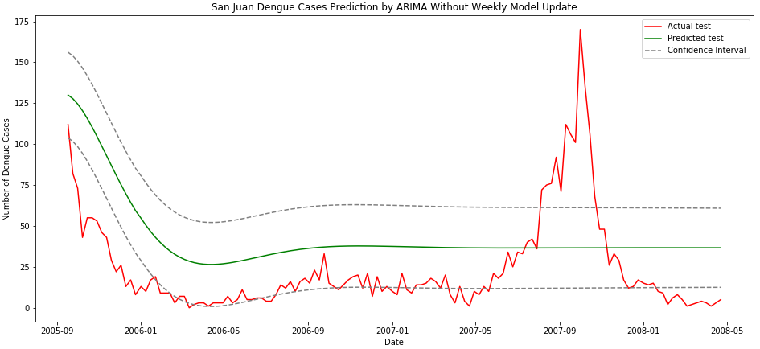
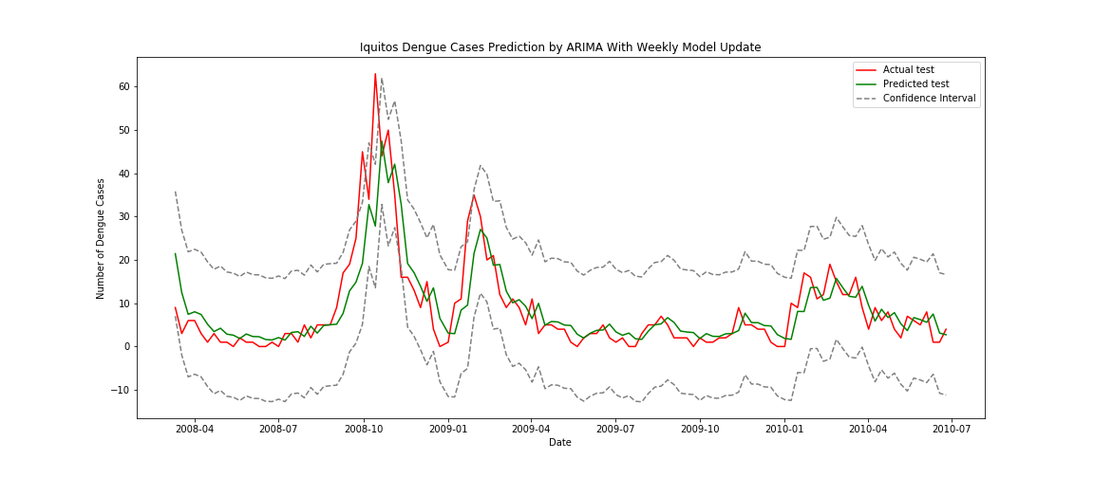
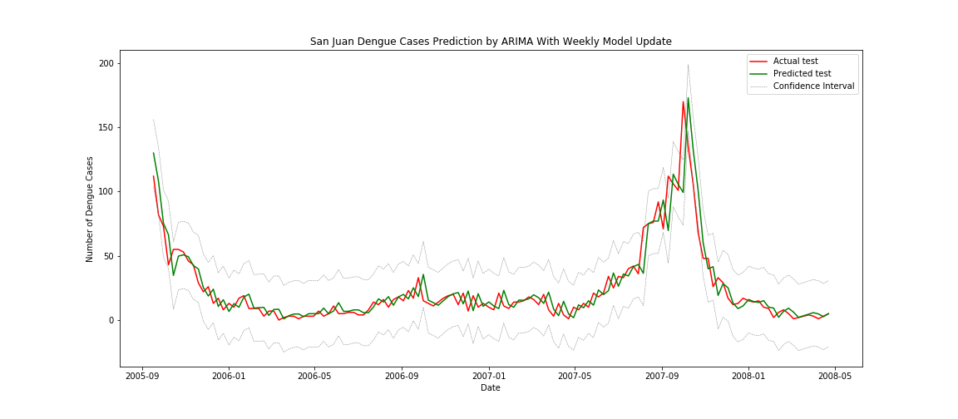
Results: Univariate ARIMA Model
One-time Prediction with ARIMA
ARIMA model succeeds by retraining on new data as it becomes available to predict subsequent values.
Predictions become more accurate as information is added to the model.
Good for short-term forecasting, but less effective for long-term predictions.
ARIMA Re-trained “Weekly”

Slide 13
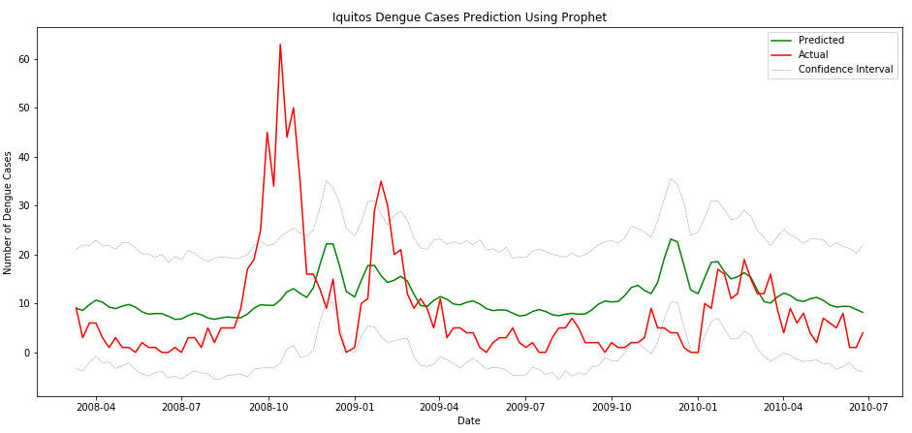
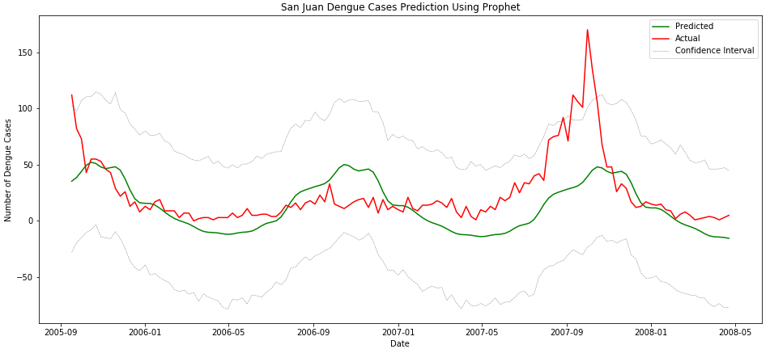
Results: Univariate Prophet Model
Takes seasonality into account, especially over several years of data.
Handles missing data and shifting trends.
OK for long term prediction and identifying when peaks will occur; less successful at predicting nuances of outbreak scale.

Slide 14
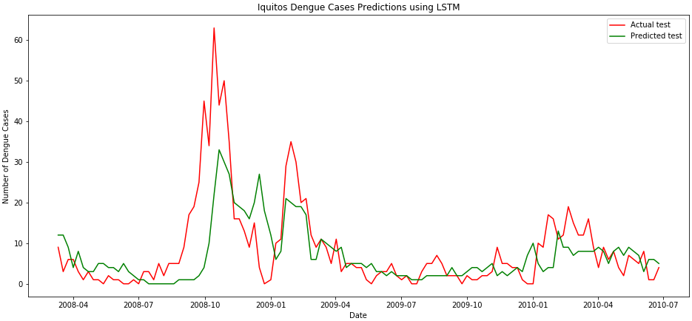
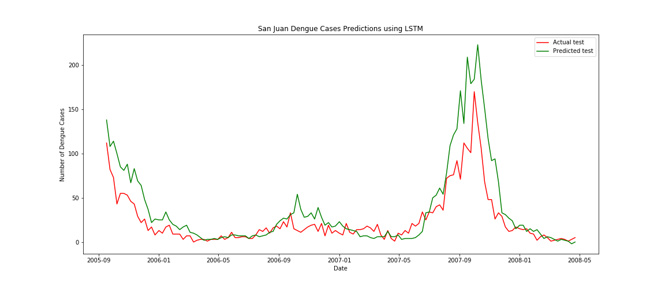
Results: Multivariate LSTM Model
Recurrent neural network learns from trend, seasonality, and other features, balancing “old memory” with new input.
Better predictor of peak values than other methods; still came up short on magnitude.
More flexible short term predictions that can adapt to changing climate conditions in the future.

Slide 15
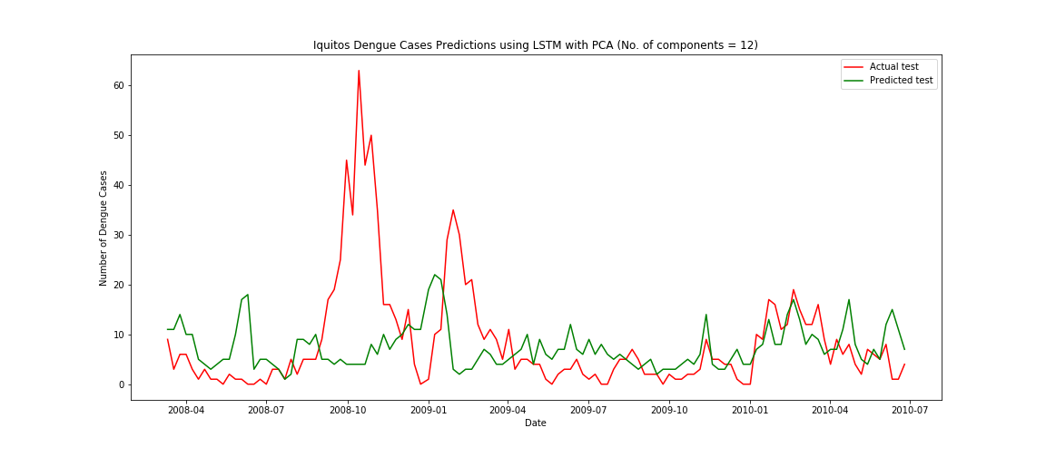
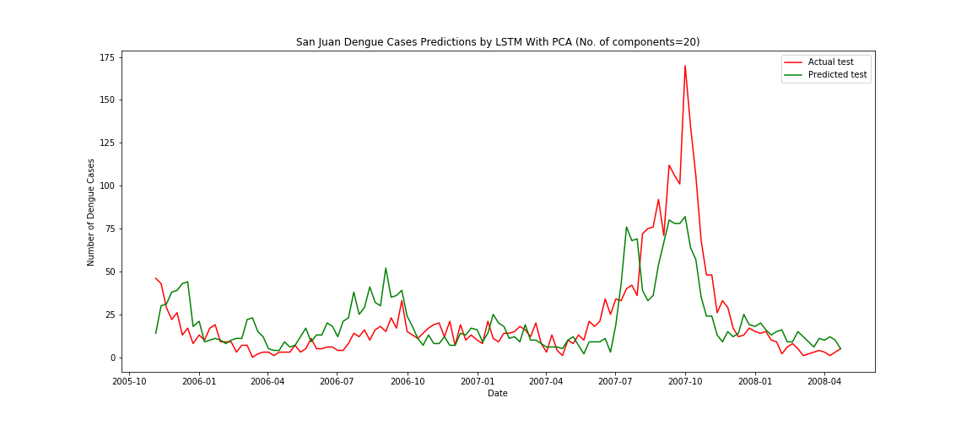
PCA Impact on Multivariate LSTM
LSTM without PCA
The LSTM model performs better with feature selection (top charts) over feature extraction (PCA) (bottom charts).
The best feature selection model required only 11 features for each city, while the best PCA model required 20 features for SJ and 12 features for Iquitos.
Both models are able to predict the occurrence of outbreaks, but the PCA version is less accurate in predicting the number of cases per week.
LSTM with PCA

Slide 16
Discussion
Method | Requirements | Pros (+) | Cons (-) | MAE
ARIMA | Uniform intervals of measurement Stationarity (or related transformation) | Accounts for trends and seasonality Simple, univariate approach Good for short-term forecasts | Requires re-training with new inputs Does not account for factors other than time steps and target variable Only predicts one week out | San Juan: 29.69 (1) 7.19 (2)
 |  |  |  | Iquitos: 8.14 (1) 3.80 (2)
Prophet Forecasting Model | Only requires time and target variables | More flexible than traditional time series models Gives a general idea of when outbreaks may occur Generates long-term predictions | Applies seasonality and trends to all intervals, whether relevant or not Does not predict outbreak magnitude well Cannot accommodate multivariate inputs | San Juan: 19.43
 |  |  |  | Iquitos: 7.92
LSTM Neural Network | Data must be reshaped into a 3D array | Handles long-term changes in relationship between features while also responding to short-term variation Identifies timing and relative scale of outbreak | Does not fully predict extreme outbreak levels Only predicts one week out | San Juan: 14.39
 |  |  |  | Iquitos: 5.01
(1) without weekly model update; (2) with weekly model update

Slide 17
Questions?

Slide 18
Thank You!

Slide 19
References
Title page image: https://www.drawingtutorials101.com/how-to-draw-a-mosquito
[1] “Dengue Fever.” Wikipedia, Accessed 22 October 2019, https://en.wikipedia.org/wiki/Dengue_fever
[2] “Mosquito-borne Disease.” Wikipedia, Accessed 22 October 2019, https://en.wikipedia.org/wiki/Mosquito-borne_disease]
[3] Climate change impacts on Dengue virus vectors: https://royalsocietypublishing.org/doi/full/10.1098/rstb.2014.0135
[4] “DengAI: Predicting Disease Spread.” DrivenData, Accessed 22 October 2019, https://www.drivendata.org/competitions/44/dengai-predicting-disease-spread/page/80/
[5] “Dengue Forecasting.” National Oceanic and Atmospheric Administration (NOAA), Accessed 22 October 2019, https://dengueforecasting.noaa.gov/
[6] “Back to the Future: Using Historical Dengue Data to Predict the Next Epidemic.” Obama White House Archives, Accessed 1 December 2019, https://obamawhitehouse.archives.gov/blog/2015/06/05/back-future-using-historical-dengue-data-predict-next-epidemic
[7] “Time Series.” Wikipedia, Accessed 1 December 2019, https://en.wikipedia.org/wiki/Time_series
[8] “Components of Time Series”, Accessed 1 December 2019, https://www.emathzone.com/tutorials/basic-statistics/components-of-time-series.html
[9] “Time Series Talk: Stationarity.” YouTube, Accessed 1 December 2019, https://www.youtube.com/watch?v=oY-j2Wof51c
[10] “ARIMA Model – Complete Guide to Time Series Forecasting in Python”, Machine Learning Plus, Accessed 1 December 2019, https://www.machinelearningplus.com/time-series/arima-model-time-series-forecasting-python/
[11] ”Prophet.”Facebook Open Source, Accessed 1 December, 2019. https://facebook.github.io/prophet/
[12 ]”An Intro Tutorial for Implementing Long Short-Term Memory Networks (LSTM).” Heartbeat, Accessed 1 December 2019, https://heartbeat.fritz.ai/a-beginners-guide-to-implementing-long-short-term-memory-networks-lstm-eb7a2ff09a27
[13] “How to Reshape Input Data for Long Short-Term Memory Networks in Keras.” Machine Learning Mastery, Accessed 1 December 2019, https://machinelearningmastery.com/reshape-input-data-long-short-term-memory-networks-keras/

